Slide 2
Predicting Risk for New Insurance Using Customer Information
Submitted to: Prof. Narendra Pal Singh Rathore
Department of Computer Science and Engineering

Slide 3
Supervised by: Prof.Narendra Pal Singh Rathore
Team Members
1.Durgesh Sharma
2.Harshala Gaikwad
3.Kartavya Verma

Slide 4
Project Presentation Outline
Abstract
Introduction
Problem Statement
Survey of Existing Systems
Project Objectives
Requirement Analysis
Solution Proposed
Models and Diagrams
The Implementation
Testing
The Outcome Discussion
Conclusions and Limitations

Slide 5
Abstract
Insurance policies involving factors with greater risk of claims are charged at a higher rate. With much information at hand, insurers can evaluate risk of insurance policies at much higher accuracy.
With the increase in the amount of data and advances in data analytic, the underwriting process can be automated for faster processing of applications. This project aims at providing solutions to enhance risk assessment among life insurance firms using predictive analytic.

Slide 6
Introduction
Risk assessment is a crucial element in the life insurance business to classify the applicants. Companies perform underwriting process to make decisions on applications and to price policies accordingly.
Risk profiles of individual applicants are thoroughly analyzed by underwriters, especially in the life insurance business. The job of the underwriter is to make sure that the risks are evaluated, and premiums as accurately as possible to sustain the smooth running of the business.
The use of advanced data mining techniques to improve decision making has already taken root in property and casualty insurance as well as in many other industries.

Slide 7
The Problem Statement
Risk management is important for insurance industry to identify new authenticated customers. Insurers consider every available quantifiable factor to develop profiles of high and low insurance risk. Level of risk will be able to determine the expected insurance premiums. Generally, insurance policies involving factors with greater risk of claims are charged at a higher rate. With much information at hand, insurers can evaluate risk of insurance policies at much higher accuracy.
For this insurer collect a vast amount of information about policy holders and insured objects. Statistical methods and tools based on data mining techniques can be used to analyze or to determine insurance policy risk levels.

Slide 8
Survey of Existing Systems
No. | Existing system/website/software | Features | Disadvantages | Limitations/Gaps
1. | Predictive Modeling for Life Insurance | In this different ways of data mining and multivariate analytic techniques was described that can be used to improve decision making processes in such functions as life insurance underwriting and marketing. | Risk factor and mean standard evaluation is not done. | Data used was limited.
2. | Insurance Claim Analysis Using Machine Learning Algorithms | In this system,several machine learning techniques to analysis the insurance claims efficiently and compare their performances using various metrics. | Security risk with a lot of confidential data of the user. | Data security.

Slide 9
Survey of Existing Systems
No. | Existing system/website/software | Features | Disadvantages | Limitations/Gaps
3. | Predictive Modeling for Life Insurance | This system illustrate the general processes that can be used to implement predictive modeling in life insurance underwriting and marketing. | User data collection was not up-to the mark. | Unpredictability of the result.

Slide 10
Objectives
The purpose of this project is to apply predictive modeling to classify the risk level based on the available past data in the life insurance industry and customer information and recommend the most appropriate model to assess risk and provide solutions to refine underwriting processes.
Companies that underwrite life insurance policies have to evaluate applications carefully. The payouts from life insurance claims are very high relative to the insurance premiums that companies collect from an individual customer.So, this project will surely reduce the high cost payouts life insurance claims.

Slide 11
Requirement Analysis
FUNCTIONAL REQUIREMENTS
Obtaining Applicant Data
Preparing Dataset
Data Cleaning
Choosing Appropriate Model
Evaluate Risk Level

Slide 12
Requirement Analysis
NON-FUNCTIONAL REQUIREMENTS
Accuracy & Performance:
Our model provide the result with high accuracy.
Reliability:
Our model is highly reliable for each individual predictions
Maintainability:
It can easily maintained and modified by intended insurers.
Accessibility:
It can be accessible by any authenticated user

Slide 13
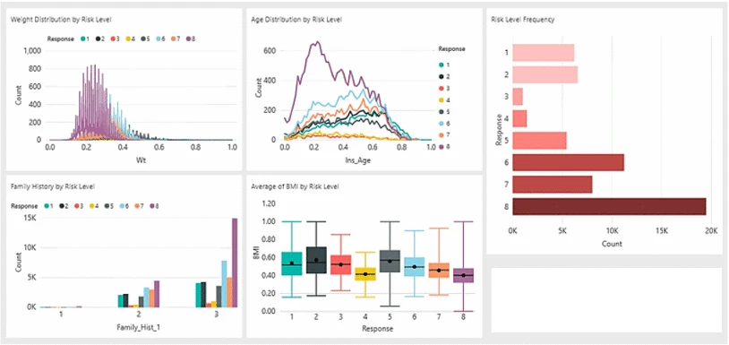
Solution Proposed
This project aims to apply predicting modelling techniques that accurately classifies risk using a more automated approach to classify risk level based on past data in insurance industry and customer information

Slide 14
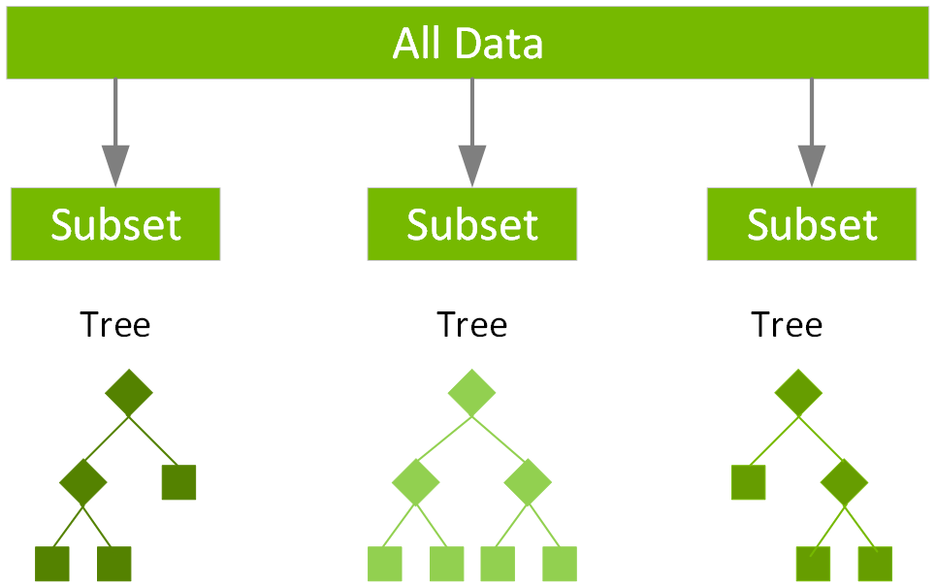
Solution Proposed
In this project we have used the XGBoost algorithm. XGBoost is an ensemble learning algorithm meaning that it combines the results of many models, called base learners to make a prediction.
Just like in Random Forests, XGBoost uses Decision Trees as base learners.

Slide 15
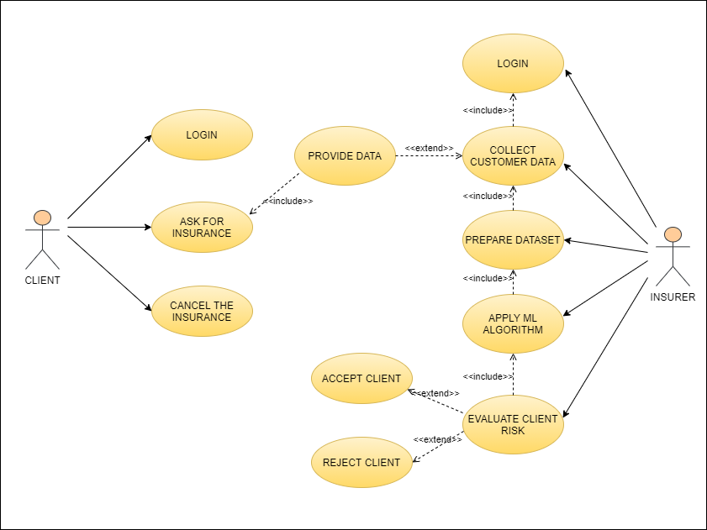
Models/Diagrams
Use Case Diagram

Slide 16
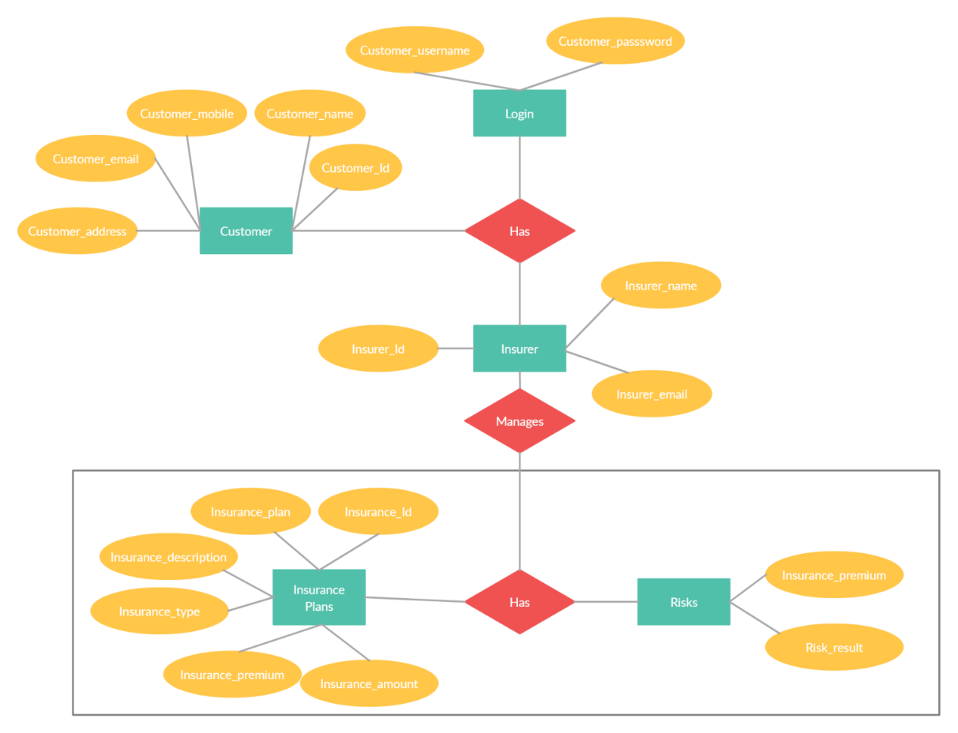
Models/Diagrams
ER Diagram

Slide 17
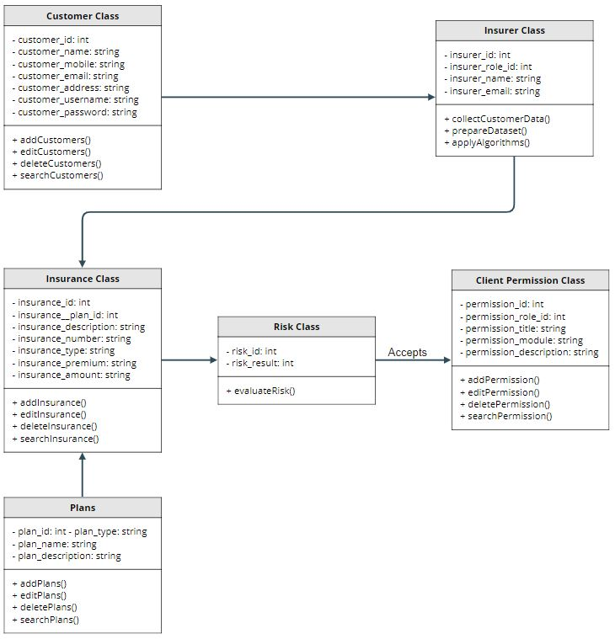
Models/Diagrams
Class
Diagram

Slide 18
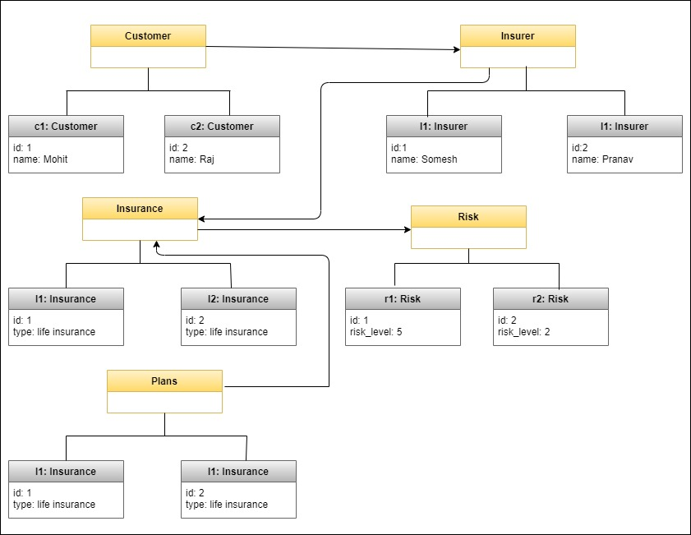
Models/Diagrams
Object Diagram

Slide 19
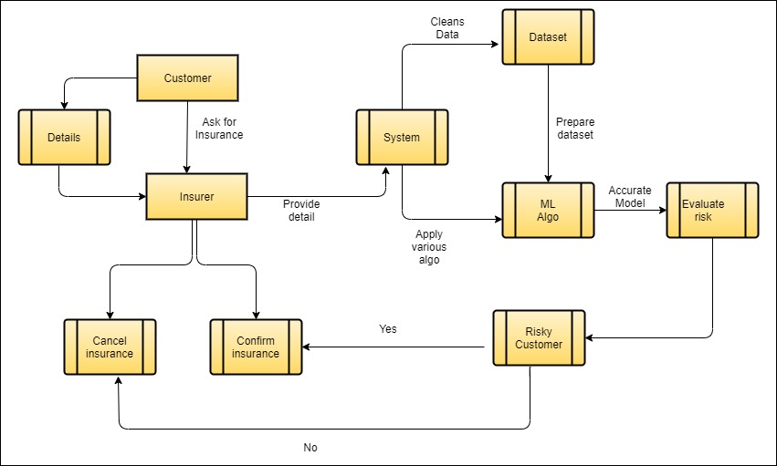
Models/Diagrams
Data Flow Diagram

Slide 20
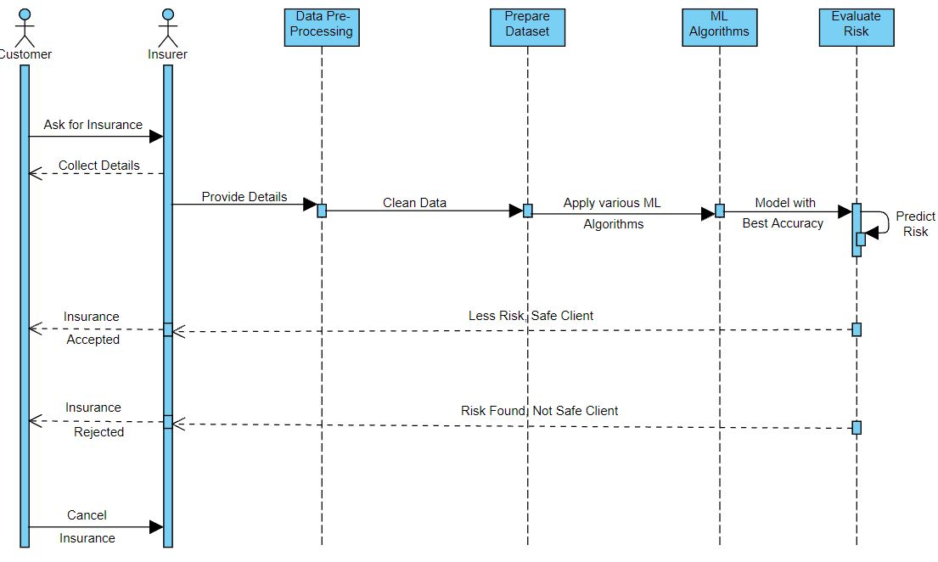
Models/Diagrams
Sequence Diagram

Slide 21
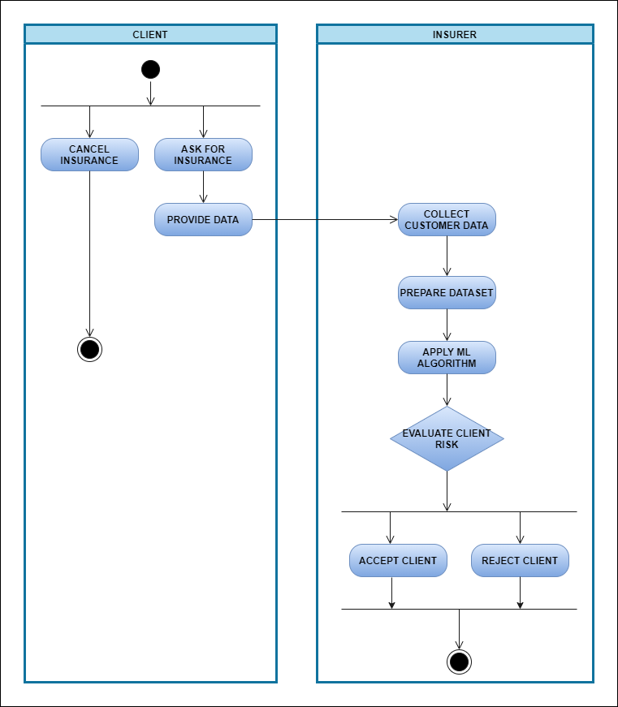
Models/Diagrams
Activity
Diagram

Slide 22
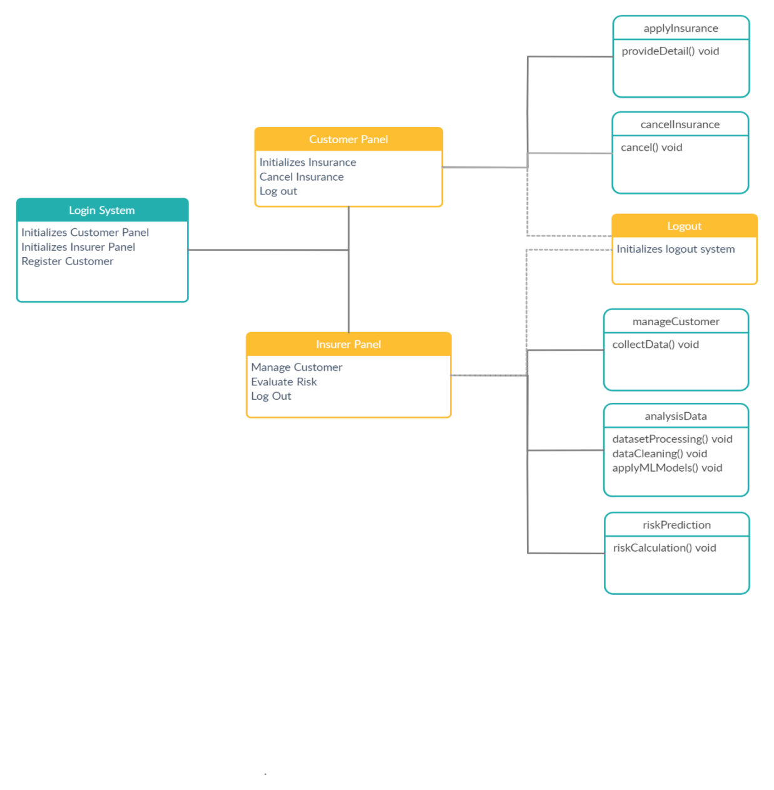
Models/Diagrams
Deployment
Diagram

Slide 23
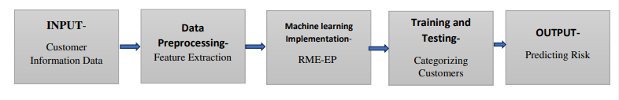
Flowchart
System Architecture

Slide 24
Implementation
The main foundational block of insurance industry is to estimate the future events and measure the associated risk of these events, hence it is needless to say that predictive analytics is used widely to determine the risk factor associated with the applicant. Analyzing thousands of applicant data manually may take large amount of time due to these reason insurance industries are considered as slow-moving industry.
In the real world, supervised learning can be used for Risk Assessment, Image classification, Fraud Detection, spam filtering, etc.
In our project we are using supervised machine learning techniques. The dataset collected from kaggle website is a labelled data that contains risk levels (1-8) as a response variable. We train our model using this dataset and try to predict the new customer’s risk level.

Slide 25
Implementation
To predict the risk level of different applicants we have use the random forest predictive model.
Random forest is a Supervised Machine Learning Algorithm that is used widely in Classification and Regression problems. It builds decision trees on different samples and takes their majority vote for classification and average in case of regression.
Once the risk level are predicted the premium for the insurance policy are displayed to the customer.

Slide 26
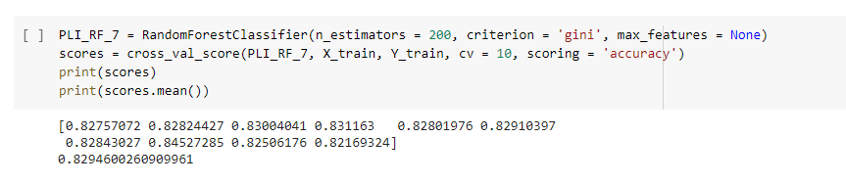
Implementation
Following is the result when K-fold cross validation is applied into the dataset using Random Forest:
Accuracy: 0.8294600260909961

Slide 27
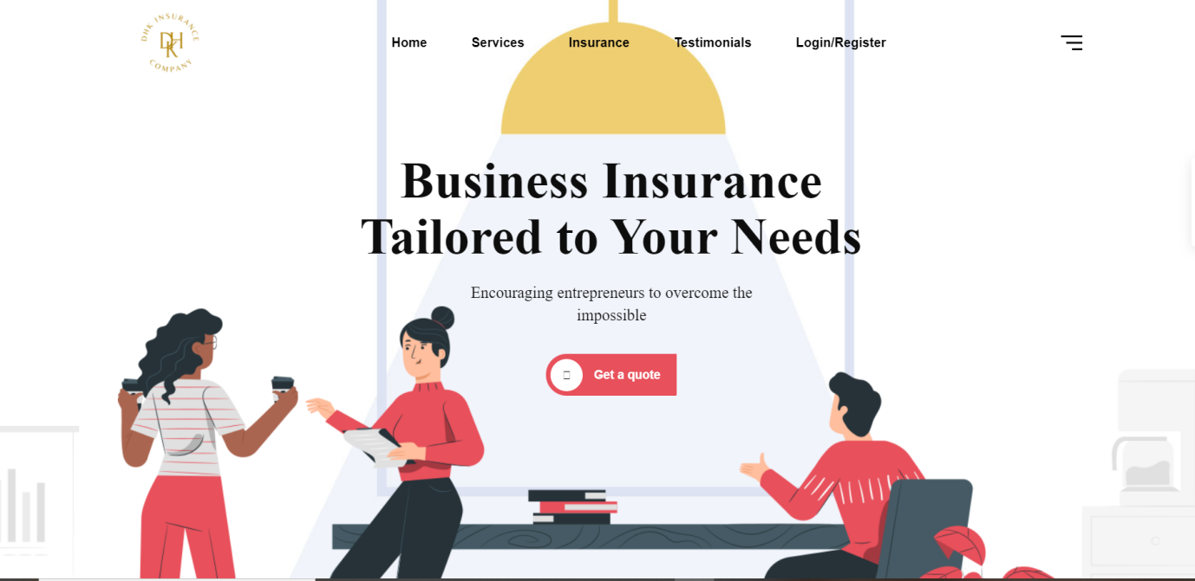
Implementation
The Following are the screenshots of the result of the project :

Slide 28
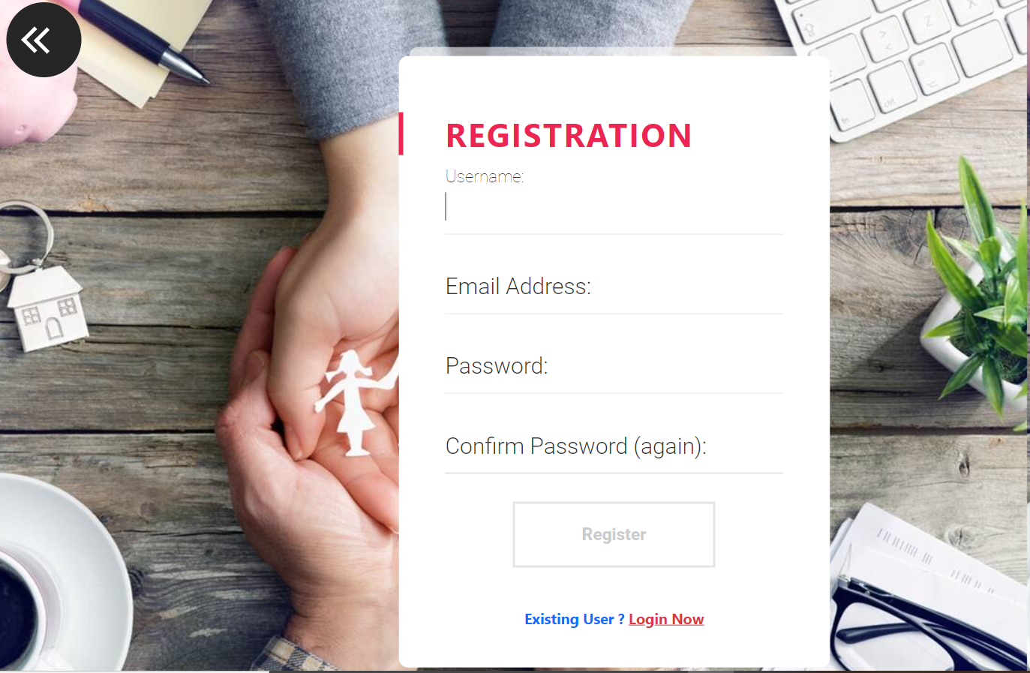
Implementation
The Following are the screenshots of the result of the project :

Slide 29
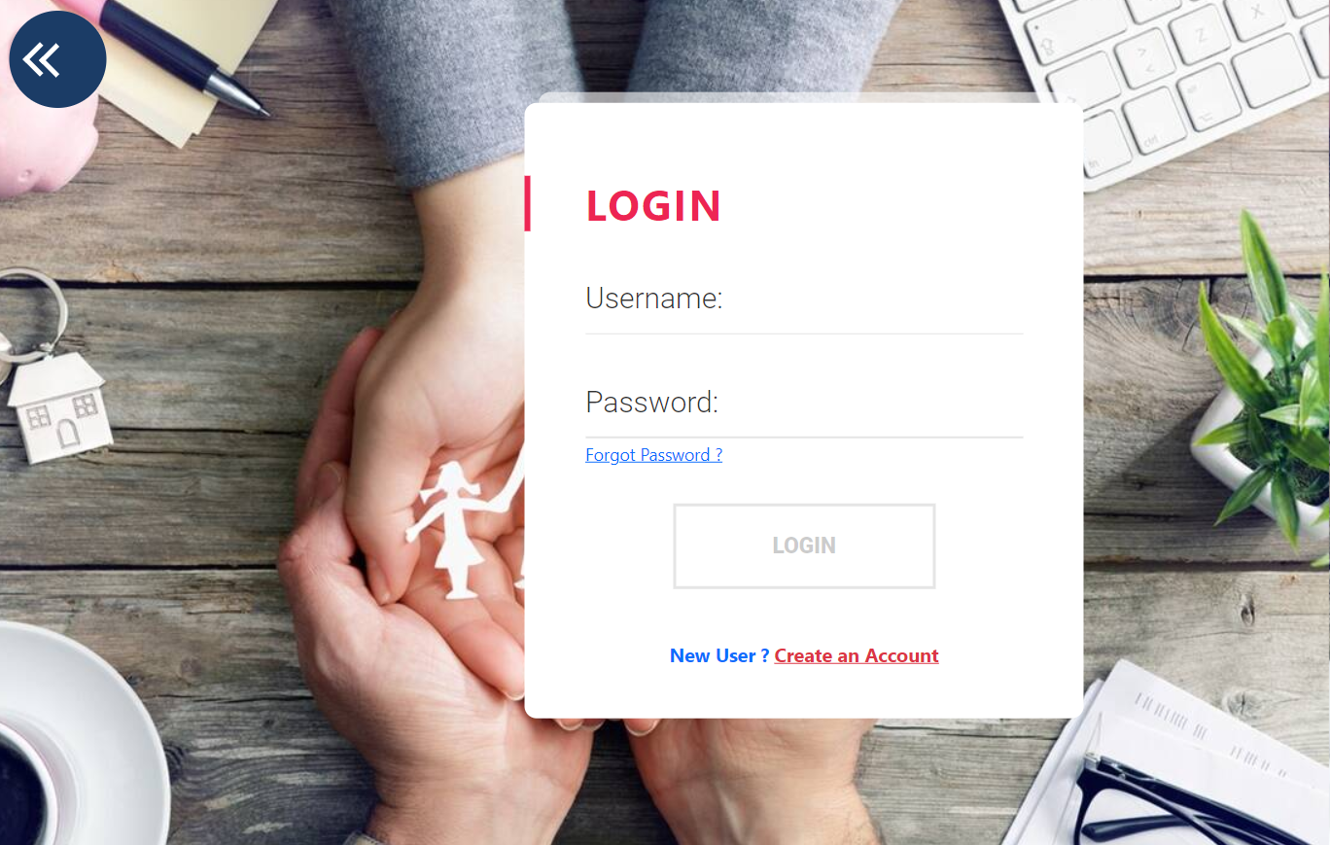
Implementation
The Following are the screenshots of the result of the project :

Slide 30
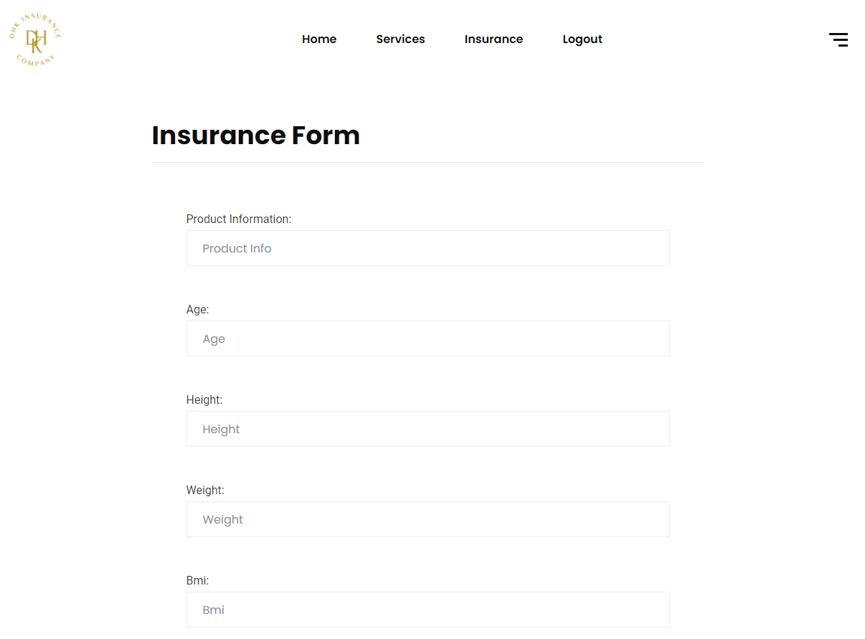
Implementation
The Following are the screenshots of the result of the project :

Slide 31
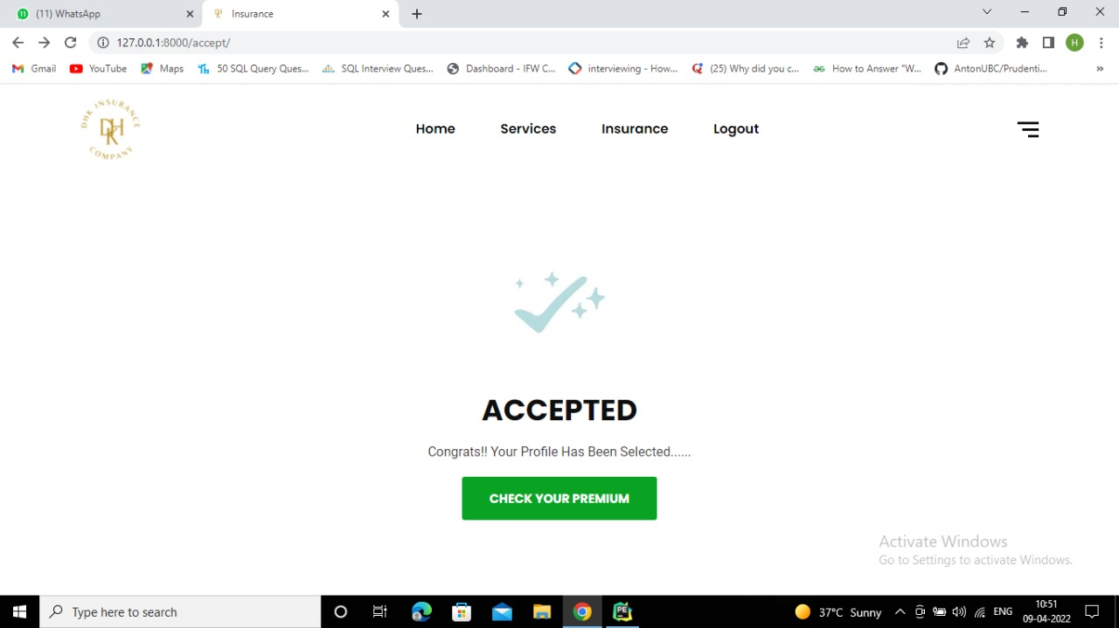
Implementation
The Following are the screenshots of the result of the project :

Slide 32
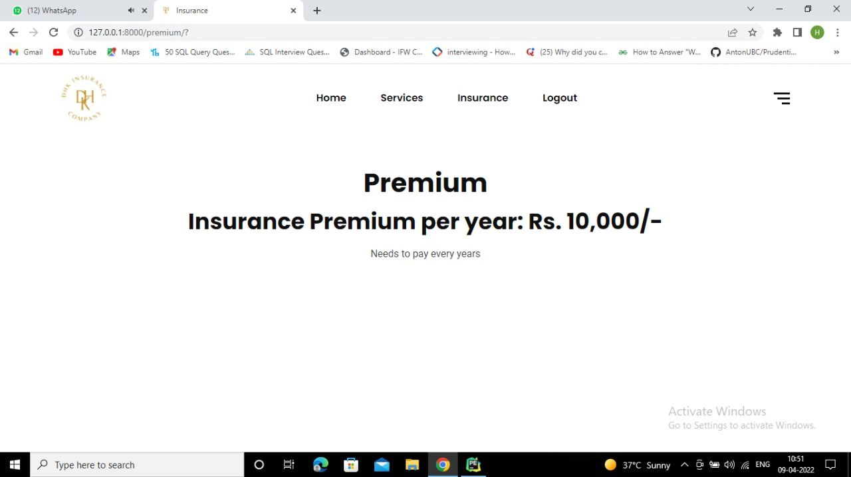
Implementation
The Following are the screenshots of the premium webpage of the project :

Slide 33
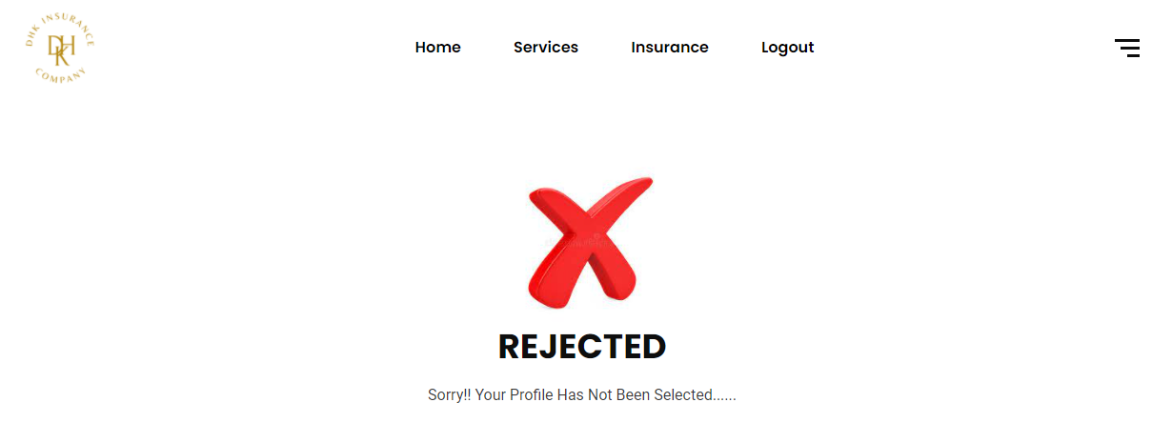
Implementation
The Following are the screenshots of the result of the project :

Slide 34
Testing/Test Cases
Testing assesses the quality of the product. It is a process that is done during the development process.
TEST CASE: 1
Test Case ID | TC001
Test Case Summary | It will check the input values from the user and according to the values it will accept or reject the insurance policy as per the machine learning algorithm
Test | User enter the values in the insurance form. Machine Learning Model gives the predicted result.
Procedure
Expected | For each user,if the insurance policy is suitable according to the parameters, the result will be accepted.
Result
Actual Result | Accepted
Display | Premium
Status | Pass
 | Test Case 1

Slide 35
Testing/Test Cases
TEST CASE: 2
Test Case ID | TC002
Test Case Summary | It will check the input values from the user and according to the values it will accept or reject the insurance policy as per the machine learning algorithm.
Test | 1.User enter the values in the insurance form.
 | 2. Machine Learning Model gives the predicted result.
Procedure
Expected | For each user,if the insurance policy is not suitable according to the parameters, the result will be rejected.
Result
Actual Result | Rejected
Status | Pass
 | Test Case 2

Slide 36
Conclusion and Limitation
Conclusion:-
Data analytics is now the trend that is gaining signiﬁcance among companies worldwide. In the life insurance domain, predictive modeling using learning algorithm scan provide the notable difference in the way which business is done as compared to the traditional methods.
Previously, risk assessment for life underwriting was conducted using complex actuarial formulas and usually was a very lengthy process. Now, with data analytical solutions, the work can be done faster and with better results.
Therefore, it would enhance the business by allowing faster service to customer, thereby increasing satisfaction and loyalty.

Slide 37
Conclusion and Limitation
Limitation:-
Some of the challenges insurers typically encounter when adopting machine learning are:
Training requirements
Right data source
Difficulty in predicting returns
Data security

Slide 38
Acknowledgment
We as the authors would like to extend a special thanks of vote to the Prof.Narendra Pal Singh Rathore, our guide for their valuable guidance and suggestions to improve this project without which it would have been a very difficult task. This project is supported by Acropolis Institute of technology and Research, Indore.

Slide 39
Q&A

Slide 40
THANKS

